Slide 1

Kaitlyn Johnson
Personal User Manual 2022

Slide 2
My Style:
I am very organized and like to have a plan of attack for everything I do. I believe that life is one big chess game where we get to pick which player we are. I am totally willing to listen to other points of view, however, and I like to get contrast as well. I believe that gets the best final solution.
I like to delve into the heart of the problem rather than the surface issues. I am ok with talking about surface issues, but if we never tackle the crux of the issue, what is the point of what we are trying to accomplish.
I believe that there is beauty in just about everything we do, everything around us, and in everyone. It is our responsibility to identify those things and share that happiness with those around us.
I LOVE to learn and am very curious by nature.

Slide 3

What I Value:
Hard work reaps rewards:
I am a firm believer in working hard regardless of the situation you are placed. Staying focused and organized during these times are necessary to me as well.
Integrity begets loyalty:
Integrity in all situations is super important to me. I believe this helps to foster strong relationships and develop a better individual.
Respect and Kindness are not optional:
Everyone deserves to be given the opportunity to have their opinions shared and be treated kindly and respectfully. No one should feel left out on their team.

Slide 4
How I like People to communicate with me:
I am a firm believer that meetings are meant to be kept short and to the point. If information can be/is shared ahead of time, I do not see the need of holding another meeting to address the same information.
I prefer when people are upfront with me about their concerns. I am absolutely willing to talk through their concerns, but I can not do that if they do not talk to me.
I am a very curious person by nature, and I like to ask a lot of questions. I prefer when those I am working with ask questions, especially if they are confused. I am not afraid to have people question me; I prefer that to having people confused or in disagreement.

Slide 5

What i will not tolerate:
Patronization:
I do not tolerate being talked down to or when those around me are treated the same way. I feel like it is an insult to my intellect and degrading to me as an individual.
Unkindness:
When individuals are unkind to each other, it really bothers me. We are all children of God and need to treat each other as such.
Laziness:
If I start a task, I want to finish it in the best and most efficient way possible. When an individual decides to waste the team’s time by not doing their part, it really bothers me.

Slide 6
How I make decisions:
I try to make decisions firmly and decidedly. I tend to do this quickly and methodically and then stick to them. It is hard for me to dramatically change plans late in the game, and it is stressful for me when my team decides to do so.
I try to think through my decisions very carefully and from as many angles as possible. I believe that being observant before the decision-making process begins helps minimize the time needed to get an informed decision.
I will almost always choose to act logically versus emotionally when making a decision.I am firmly in the head over heart opinion and embrace a sense of cold clarity.
If the Spirit tells me what decision to make, I am going to act of that right away, even if it is contrary to my normal ideas. I will even go against a team if I feel it is what God wants me to do. I will have no shame in doing so.

Slide 7
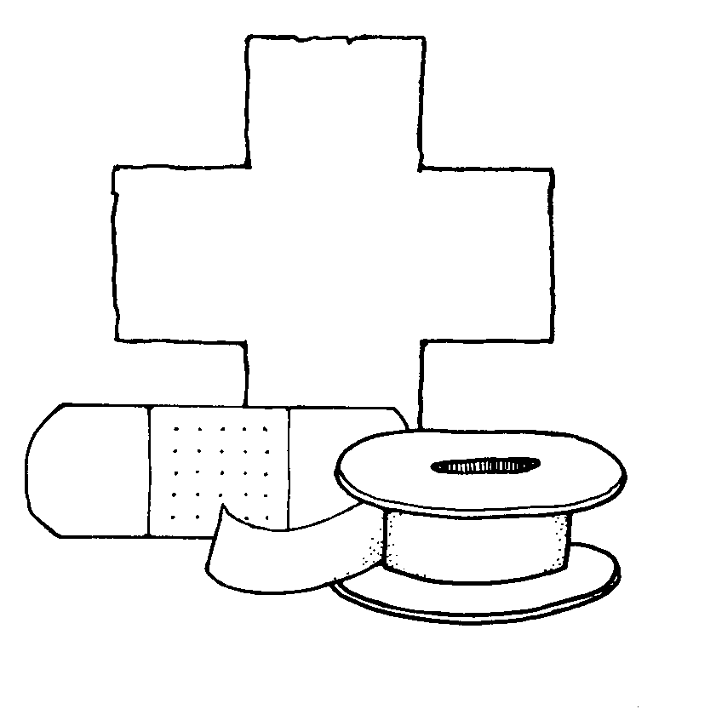
How to help me:
Talk to me straight:
I am not always the best at picking up on small cues. It is far better for me if you are overt in your explanations than covert.
Remind me to breath:
When I am really focused on a task, I tend to not take breaks or relax. Sometimes, I just need someone to call me out on my crazy focused nature.
Be punctual:
This is pretty self explanatory. Lives will not be lost if everyone shows up on time and does their work:)

Slide 8
What people misunderstand about me:
I am very serious about school and studying and spend quite a lot of time studying. People have often gotten this confused (They think I slack off in school) because I enjoy being social and going to events. I just don’t sleep:)
I have a pretty intense dichotomy in my extroverted and introverted natures. While I like to talk to people and connect with them, I much prefer to listen and ask questions when needed. When I am quiet, people often assume that I am being pretentious or are offended; I am just listening/observing.
Even though I am very organized, I still like to have fun. I just put it into my schedule. A lot of people think that is strange, but it works for me.

